Slide 1
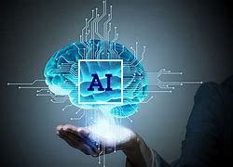
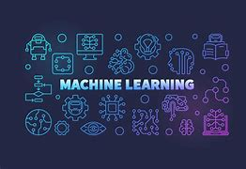
Introduction to ML

Slide 2
What is Machine Learning – Tom Mitchell
Machine learning is a form of artificial intelligence
Machine learning is a sub-category of artificial intelligence and effectively automates the process of analytical model building and allows machines to adapt to new scenarios independently.
Machine learning (ML) is a type of artificial intelligence (AI) that allows software applications to become more accurate at predicting outcomes without being explicitly programmed to do so. Machine learning algorithms use historical data as input to predict new output values.
Recommendation engines are a common use case for machine learning. Other popular uses include fraud detection, spam filtering, malware threat detection, business process automation (BPA) and predictive maintenance.

Slide 3
Machine Learning
Why is machine learning important?
Machine learning is important because it gives enterprises a view of trends in customer behavior and business operational patterns, as well as supports the development of new products. Many of today's leading companies, such as Facebook, Google and Uber, make machine learning a central part of their operations. Machine learning has become a significant competitive differentiator for many companies.
What are the different types of machine learning?
Classical machine learning is often categorized by how an algorithm learns to become more accurate in its predictions. There are four basic approaches:supervised learning, unsupervised learning, semi-supervised learning and reinforcement learning. The type of algorithm data scientists choose to use depends on what type of data they want to predict.

Slide 4
Machine Learning
Supervised learning: In this type of machine learning, data scientists supply algorithms with labeled training data and define the variables they want the algorithm to assess for correlations. Both the input and the output of the algorithm is specified.
Unsupervised learning: This type of machine learning involves algorithms that train on unlabeled data. The algorithm scans through data sets looking for any meaningful connection. The data that algorithms train on as well as the predictions or recommendations they output are predetermined.
Semi-supervised learning: This approach to machine learning involves a mix of the two preceding types. Data scientists may feed an algorithm mostly labeled training data, but the model is free to explore the data on its own and develop its own understanding of the data set.
Reinforcement learning: Data scientists typically use reinforcement learning to teach a machine to complete a multi-step process for which there are clearly defined rules. Data scientists program an algorithm to complete a task and give it positive or negative cues as it works out how to complete a task. But for the most part, the algorithm decides on its own what steps to take along the way.

Slide 5
Machine Learning
How does supervised machine learning work?
Supervised machine learning requires the data scientist to train the algorithm with both labeled inputs and desired outputs. Supervised learning algorithms are good for the following tasks:
Binary classification: Dividing data into two categories.
Multi-class classification: Choosing between more than two types of answers.
Regression modeling: Predicting continuous values.
Ensembling: Combining the predictions of multiple machine learning models to produce an accurate prediction.
How does unsupervised machine learning work?
Unsupervised machine learning algorithms do not require data to be labeled. They sift through unlabeled data to look for patterns that can be used to group data points into subsets. Most types of deep learning, including neural networks, are unsupervised algorithms. Unsupervised learning algorithms are good for the following tasks:
Clustering: Splitting the dataset into groups based on similarity.
Anomaly detection: Identifying unusual data points in a data set.
Association mining: Identifying sets of items in a data set that frequently occur together.
Dimensionality reduction: Reducing the number of variables in a data set.
.

Slide 6
Machine Learning
How does semi-supervised learning work?
Semi-supervised learning works by data scientists feeding a small amount of labeled training data to an algorithm. From this, the algorithm learns the dimensions of the data set, which it can then apply to new, unlabeled data. The performance of algorithms typically improves when they train on labeled data sets. But labeling data can be time consuming and expensive. Semi-supervised learning strikes a middle ground between the performance of supervised learning and the efficiency of unsupervised learning. Some areas where semi-supervised learning is used include:
Machine translation: Teaching algorithms to translate language based on less than a full dictionary of words.
Fraud detection: Identifying cases of fraud when you only have a few positive examples.
Labelling data: Algorithms trained on small data sets can learn to apply data labels to larger sets automatically.
How does reinforcement learning work?
Reinforcement learning works by programming an algorithm with a distinct goal and a prescribed set of rules for accomplishing that goal. Data scientists also program the algorithm to seek positive rewards -- which it receives when it performs an action that is beneficial toward the ultimate goal -- and avoid punishments -- which it receives when it performs an action that gets it farther away from its ultimate goal. Reinforcement learning is often used in areas such as:
Robotics: Robots can learn to perform tasks the physical world using this technique.
Video gameplay: Reinforcement learning has been used to teach bots to play a number of video games.
Resource management: Given finite resources and a defined goal, reinforcement learning can help enterprises plan out how to allocate resources.

Slide 7
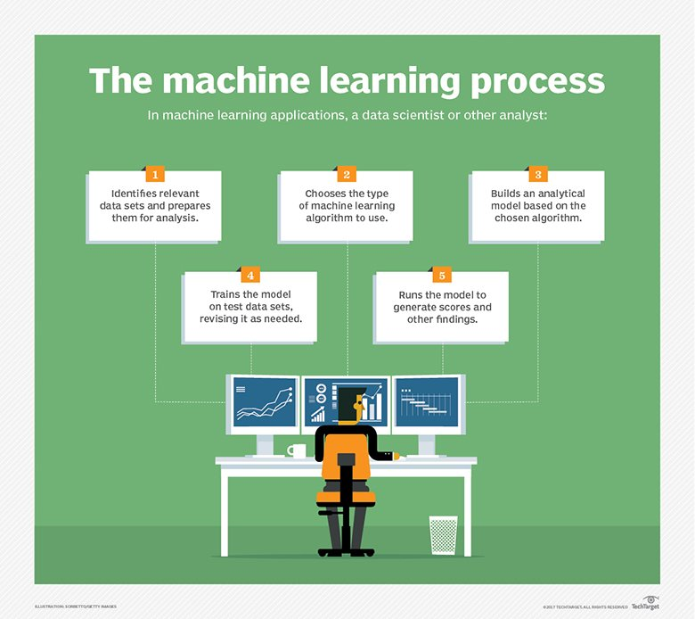
Machine Learning

Slide 8
What is Machine Learning – Tom Mitchell
The field of machine learning is concerned with the question of how to construct computer programs that automatically improve with or LEARN from experience
Tom M. Mitchell provided a widely quoted and more formal definition of the algorithms studied in the machine learning field: "A computer program is said to learn from experience E with respect to some class of tasks T and performance measure P if its performance at tasks in T, as measured by P, improves with experience E. … “
The key word here is Learning
What do mean by saying “ I am Learning”
The ability to understand and improve my work based on previous experience

Slide 9
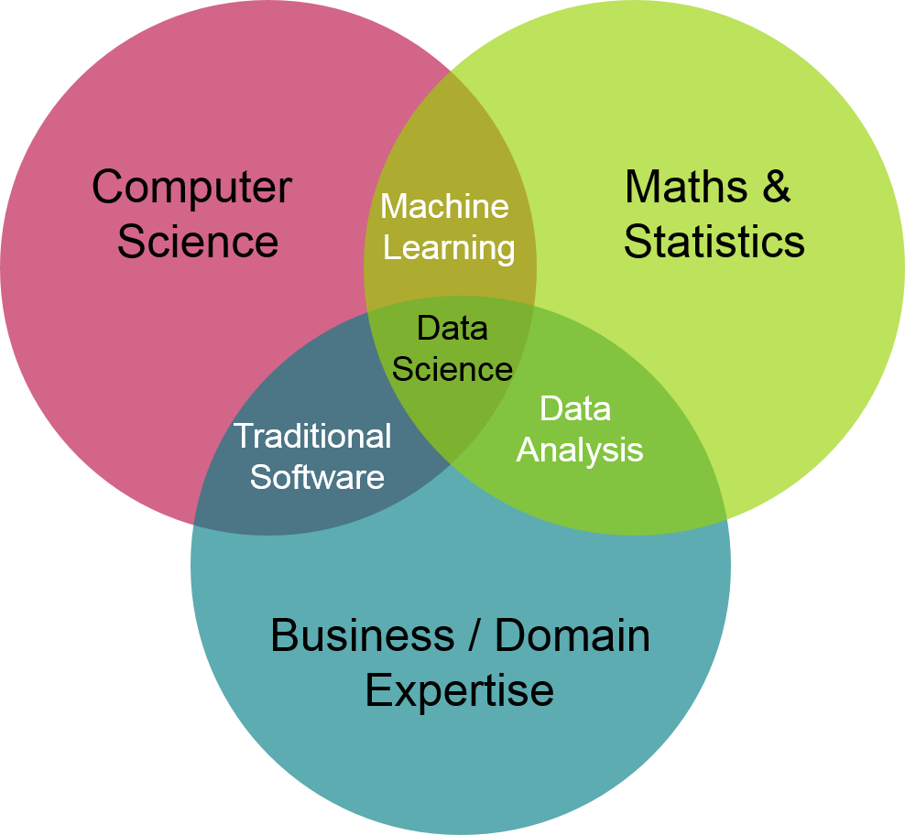
Confluence of Machine Learning
https://ion.icaew.com/itcounts/b/weblog/posts/theaccountinganddatascienceworldsmeet

Slide 10
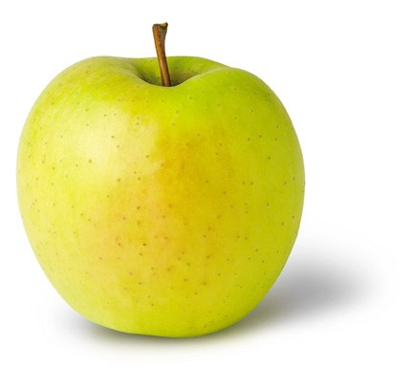
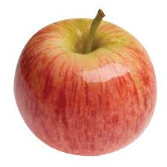

Learning (Training)
y = f(x)
output
prediction function
Image feature
Features:
1. Color: Radish/Red
2. Type : Fruit
3. Texture : Soft
4. Shape
etc…
Features:
1. Sky Blue
2. Logo:
3. Texture :
4.Shape
etc…
Features:
1. Yellow
2. Fruit
3. Texture : Soft
4.Shape
etc…
What do you mean by Apple?

Slide 11



Machine Learning Framework
Apply a prediction function to a feature representation of the image to get the desired output:
f( ) = “ apple”
f( ) = “ tomato”
f( ) = “ cow”
Training: given a training set of labeled examples {(x₁,y₁), …, (x_{N},y_{N})}, estimate the prediction function f by minimizing the prediction error on the training set
Testing: apply f to a never before seen test example x and output the predicted value y = f(x)
Slide credit: L. Lazebnik

Slide 12
What is what in ML
In machine learning the pictures or words or actual numbers are the – DATA – this is ‘x’ the input variable
The names you gave for those pictures – LABELS or OUTPUT -- labeled output
Program writing in Python, R or C++ -- LEARNING ALGORITHM -- this is the program you write in python
The equations which you have built – the model of an apple you have in mind - MODEL – The model is also the function “ f “
Then when a real apple is then shown to you, then you say it is an apple, this is the PREDICTED OUTPUT – ‘ y’

Slide 13
Machine Learning - Terminology
Features
The number of features or distinct traits that can be used to describe each item in a quantitative manner
Samples
A sample is an item to process (e.g. classify). It can be a document, a picture, a sound, a video, a row in database or CSV file, or whatever you can describe with a fixed set of quantitative traits.
Feature vector
is an n-dimensional vector of numerical features that represent some object.
Feature extraction
Preparation of feature vector
transforms the data in the high-dimensional space to a space of fewer dimensions.
Training/Evolution set
Set of data to discover potentially predictive relationships.

Slide 14
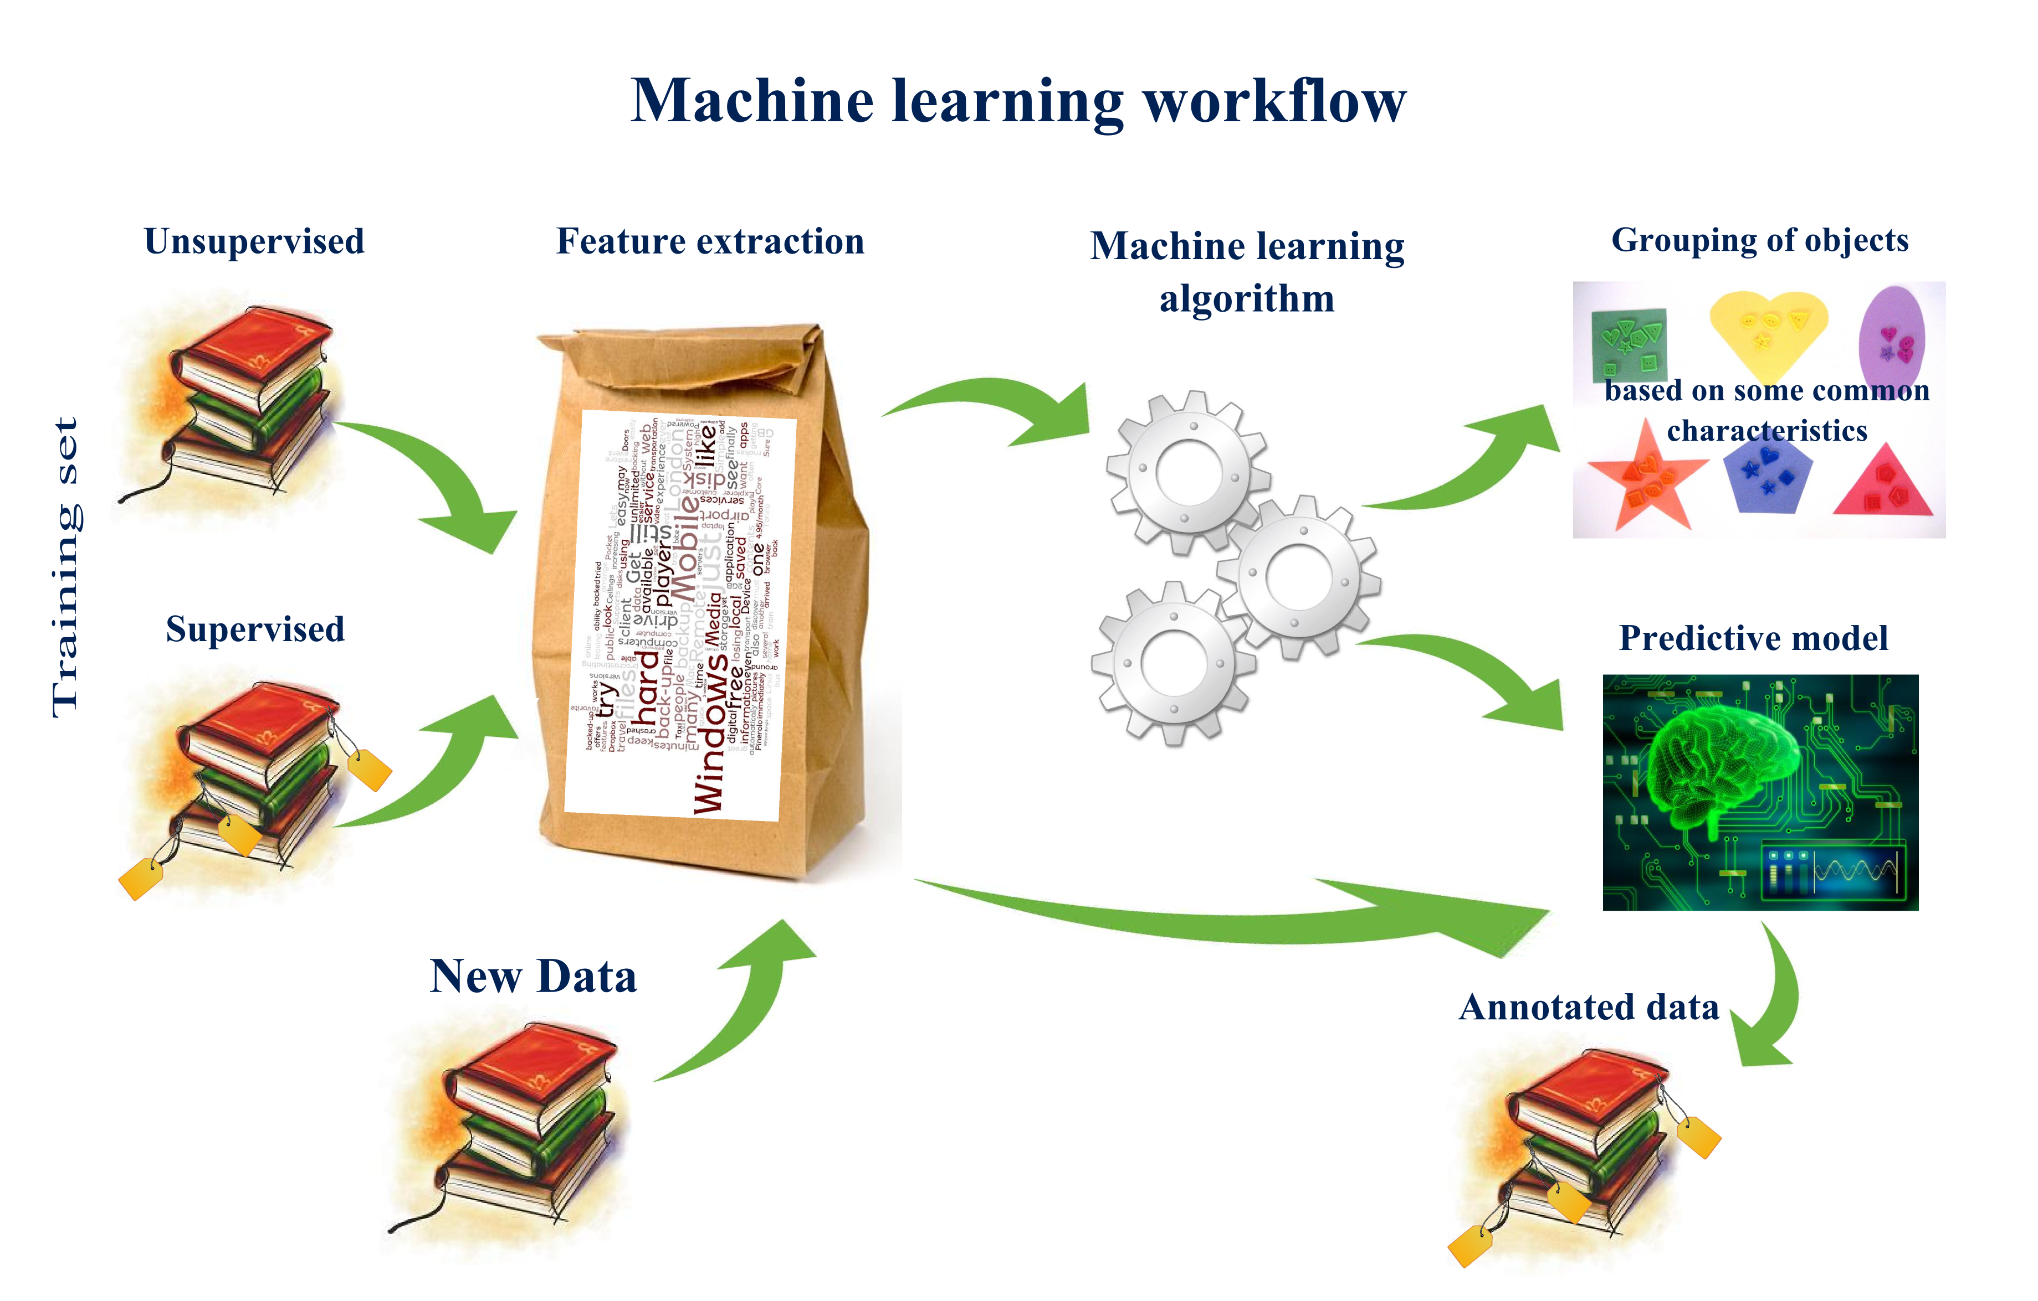
Machine Learning WorkFlow

Slide 15
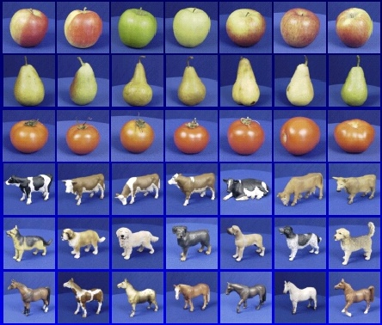

Machine Learning – How it is done?
Training
Training Labels
Training Images
Image Features
Training
Learned model
Testing
Image Features
Learned model
Prediction
Test Image
Slide credit: D. Hoiem and L. Lazebnik

Slide 16
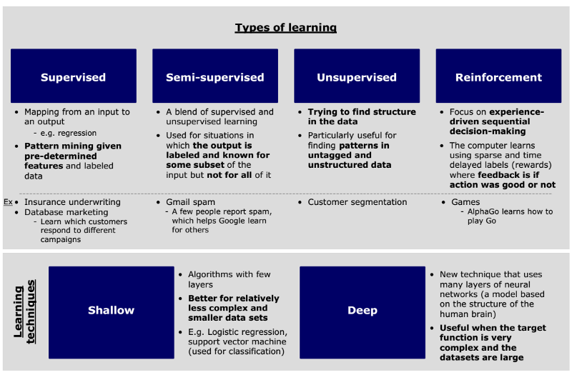
Learning Types Overview
http://sungsoo.github.io/2017/03/28/three-things-you-need-to-know-about-machine-learning.html

Slide 17
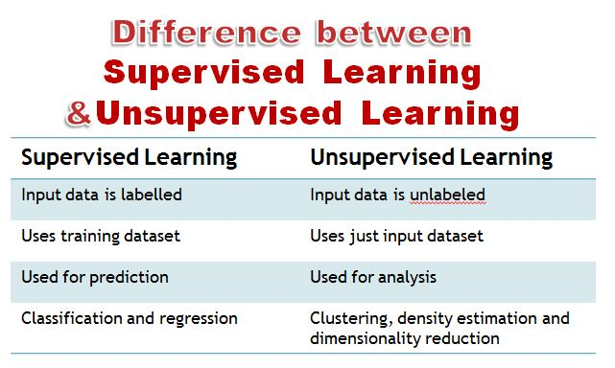
Differences

Slide 18
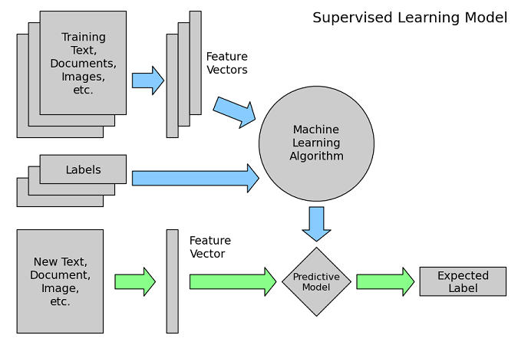
Supervised Learning

Slide 19
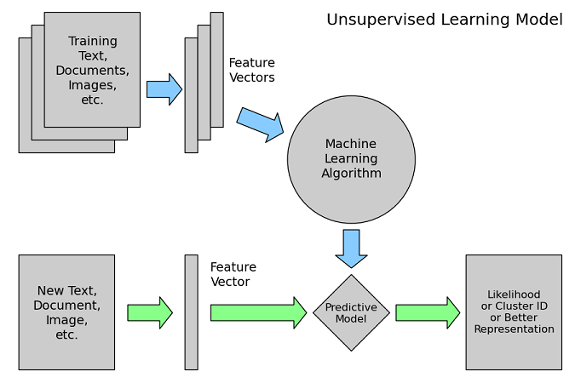
Unsupervised Learning

Slide 20
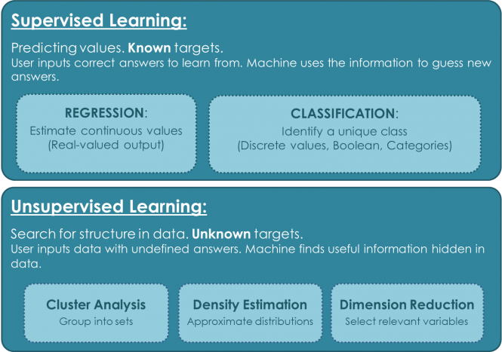
Learning Types

Slide 21
Semi-Supervised Learning
Semi-supervised learning is a class of supervised learning tasks and techniques that also make use of unlabeled data for training – typically a small amount of labeled data with a large amount of unlabeled data

Slide 22
Reinforcement Learning
Reinforcement learning, in the context of artificial intelligence, is a type of dynamic programming that trains algorithms using a system of reward and punishment.
A reinforcement learning algorithm, or agent, learns by interacting with its environment. The agent receives rewards by performing correctly and penalties for performing incorrectly. The agent learns without intervention from a human by maximizing its reward and minimizing its penalty.

Slide 23
Machine Learning Techniques – a comparison with humans
What humans do | Name of that technique in Machine Learning
Predict the class of data | Classification or Categorization
Predict a numerical value, continuously varying value | Regression
Group items or products or customers to different meaningful groups | Clustering
Show similar items or products | Recommendation
Associate a new item with already selected items | Association Rule Mining
Analyze and extract knowledge from chronological data | Time Series Analysis
Choose the most important features | Dimensionality Reduction

Slide 24
Machine Learning Techniques – a comparison with humans
What humans do | What is the that technique in Machine Learning
Fit an appropriate distribution for the given data to gather density and peak information | Density estimation
Combine many methods to get a best result | Ensemble learning
Find the odd man out in the given data | Outlier detection or Novelty detection or Anomaly detection
Simulate the way the brain works and find a solution to a problem | Neural networks and deep learning – (our next session – Day 3)
Top 10 movies, Top 10 songs, Top 10 stocks to pick, Top 10 colleges to study | Ranking
Learn from criticism and praise | Reinforcement Learning
Understand how the genes retain and keep information and improvise | Genetic Algorithms

Slide 25
Classification
Classification & Clustering Algorithms
Clustering
KNN – K Nearest Neighbors
Naïve Bayes
Bayesian Networks
Perceptron
Support Vector Machines (SVM)
Decision Trees
Random Forests
Deep learning based (CNN based) classification
Logistic Regression
K – Means
Fuzzy K-Means
Mean Shift
DBSCAN
OPTICS
Hierarchical Clustering
BIRCH (Balanced Iterative Reducing and Clustering using Hierarchies)

Slide 26
Reinforcement Learning Techniques
SARSA – State Action Reward State Action
Q-Learning – ‘Q’ means Quality – quality of an action in a given state
DQN – Deep Q Network
DDPG – Deep Deterministic Policy Gradient

